Slide 1
Lecture 13 probability and random variables

Slide 2
Review From Friday 2/16

Slide 3
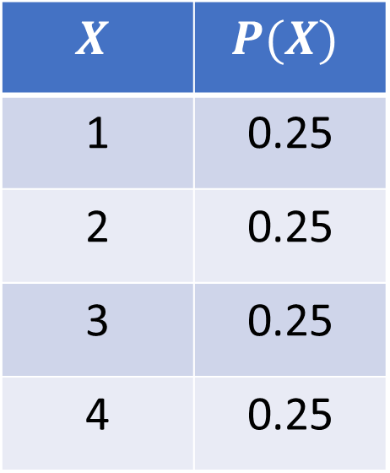
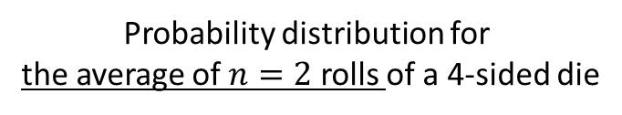
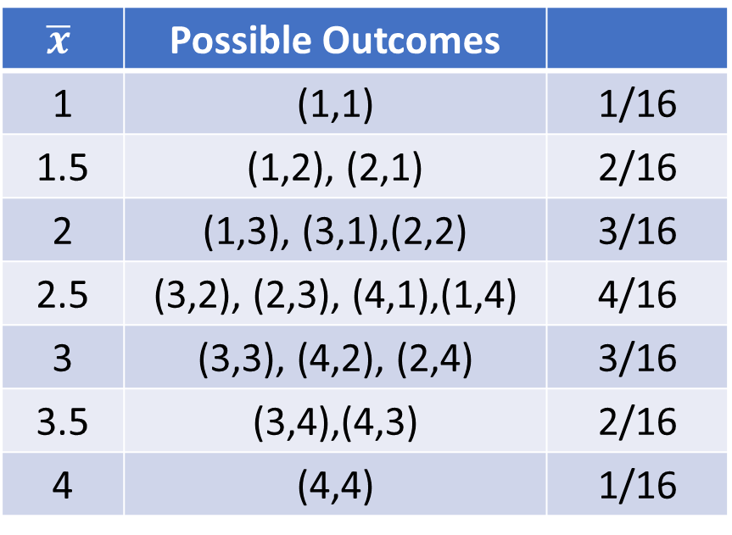
Deriving Sampling Distributions
Population Distribution
Sampling Distribution
Probability distribution for
the average of $n=2$ rolls of a 4-sided die
Probability distribution for
a single roll of a 4-sided die
$$X$$ | $$P(X)$$
1 | 0.25
2 | 0.25
3 | 0.25
4 | 0.25
$$\overline{x}$$ | Possible Outcomes
1 | (1,1) | 1/16
1.5 | (1,2), (2,1) | 2/16
2 | (1,3), (3,1),(2,2) | 3/16
2.5 | (3,2), (2,3), (4,1),(1,4) | 4/16
3 | (3,3), (4,2), (2,4) | 3/16
3.5 | (3,4),(4,3) | 2/16
4 | (4,4) | 1/16

Slide 4
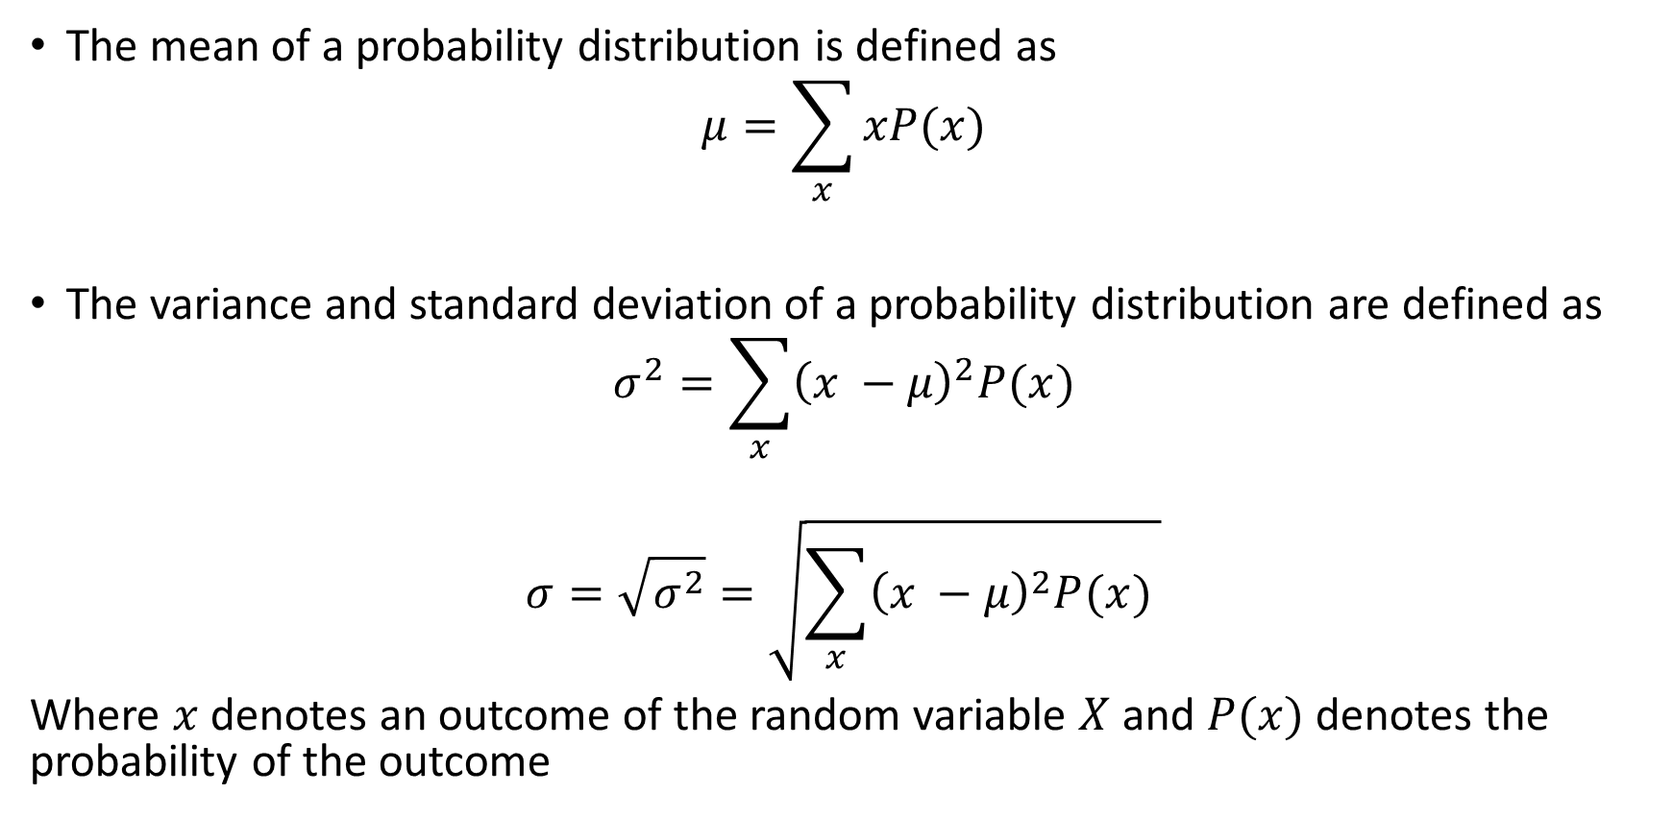
Mean and Standard Deviation of Discrete Random Variables
The mean of a probability distribution is defined as
$$μ=\sum_{x}{xP(x)}$$
The variance and standard deviation of a probability distribution are defined as
$$σ^{2}=\sum_{x}{{\left(x −μ\right)}^{2}P(x})$$
$$σ=\sqrt{σ^{2}}=\sqrt{\sum_{x}{{\left(x −μ\right)}^{2}P(x}) }$$
Where $x$ denotes an outcome of the random variable $X$ and $P(x)$ denotes the probability of the outcome

Slide 5
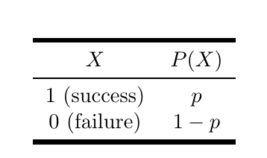
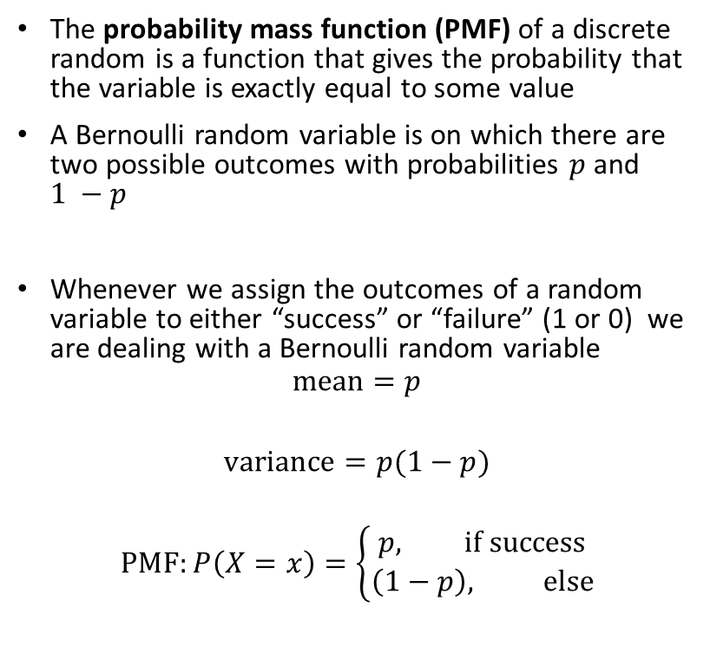
The Bernoulli distribution
The probability mass function (PMF) of a discrete random is a function that gives the probability that the variable is exactly equal to some value
A Bernoulli random variable is on which there are two possible outcomes with probabilities $p$ and $1 −p$
Whenever we assign the outcomes of a random variable to either “success” or “failure” (1 or 0) we are dealing with a Bernoulli random variable
$$mean=p$$
$$variance=p(1−p)$$
$$PMF:P\left(X=x\right)=\left\{\begin{aligned}p, if success \\ \left(1−p\right), else\end{aligned}\right.$$

Slide 6
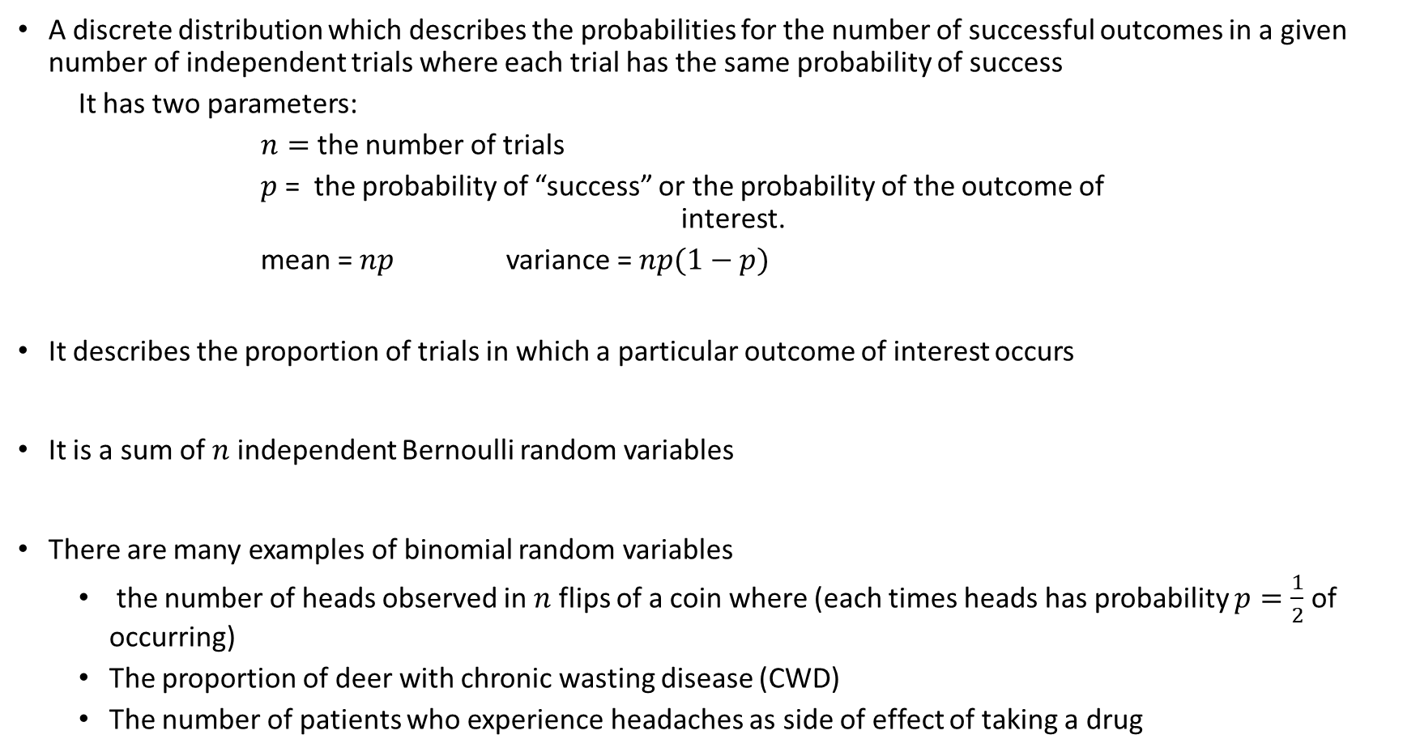
The Binomial Distribution
A discrete distribution which describes the probabilities for the number of successful outcomes in a given number of independent trials where each trial has the same probability of success
It has two parameters:
$n=$ the number of trials
$p$ = the probability of “success” or the probability of the outcome of interest.
mean = $np$ variance = $np(1−p)$
It describes the proportion of trials in which a particular outcome of interest occurs
It is a sum of $n$ independent Bernoulli random variables
There are many examples of binomial random variables
the number of heads observed in $n$ flips of a coin where (each times heads has probability $p=\frac{1}{2}$ of occurring)
The proportion of deer with chronic wasting disease (CWD)
The number of patients who experience headaches as side of effect of taking a drug

Slide 7
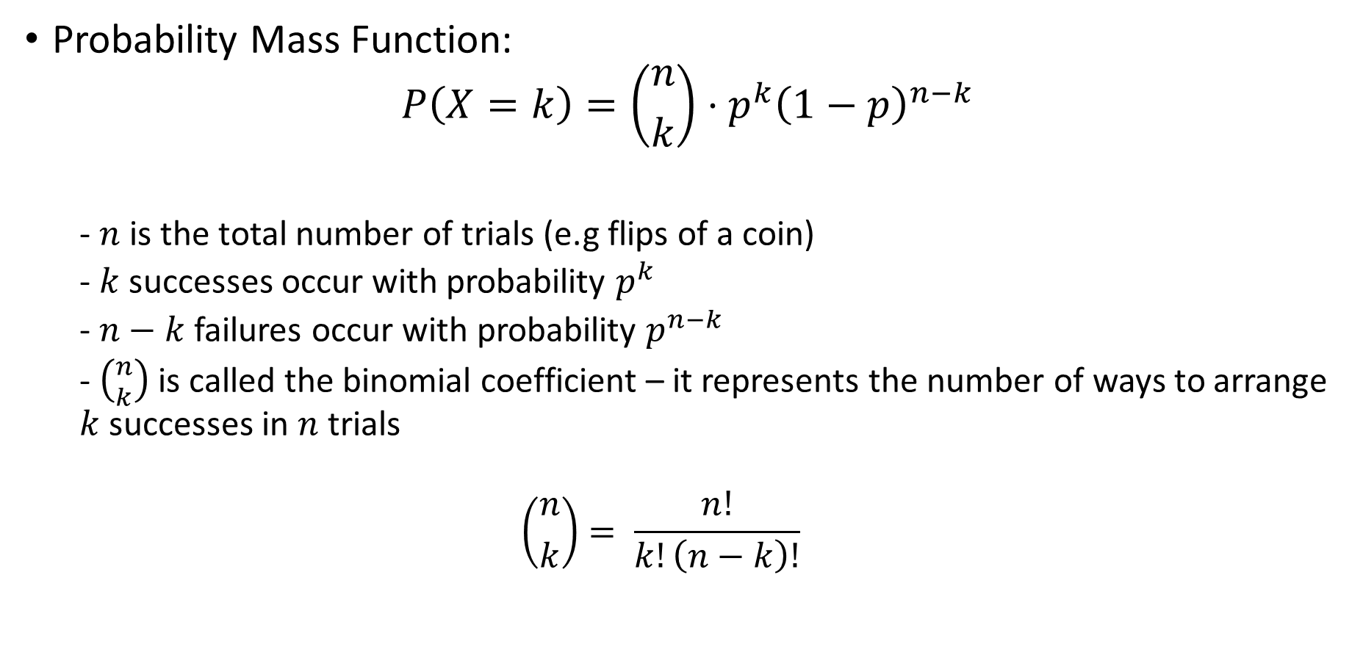
The Binomial Distribution
Probability Mass Function:
$$P\left(X=k\right)=\left({n \atop k}\right)⋅p^{k}{\left(1−p\right)}^{n−k}$$
- $n$ is the total number of trials (e.g flips of a coin)
- $k$ successes occur with probability $p^{k}$
- $n−k$ failures occur with probability $p^{n−k}$
- $\left({n \atop k}\right)$ is called the binomial coefficient – it represents the number of ways to arrange $k$ successes in $n$ trials
$$\left({n \atop k}\right)= \frac{n!}{k!\left(n−k\right)!}$$

Slide 8
Example:
The tiger trout is a sterile hybridization of a brown trout with a brook trout produced in fish hatcheries and stocked into ponds and lakes. It is a prized catch among fly fisherman. Suppose that of the 10,000 trout stocked in spring valley reservoir, 500 of them are tiger trout. Assuming that tiger trout and other species are homogeneously mixed:
what is the probability that I catch a tiger trout on my first cast?
What is the probability that I catch a tiger trout in my first 10 casts?

Slide 9
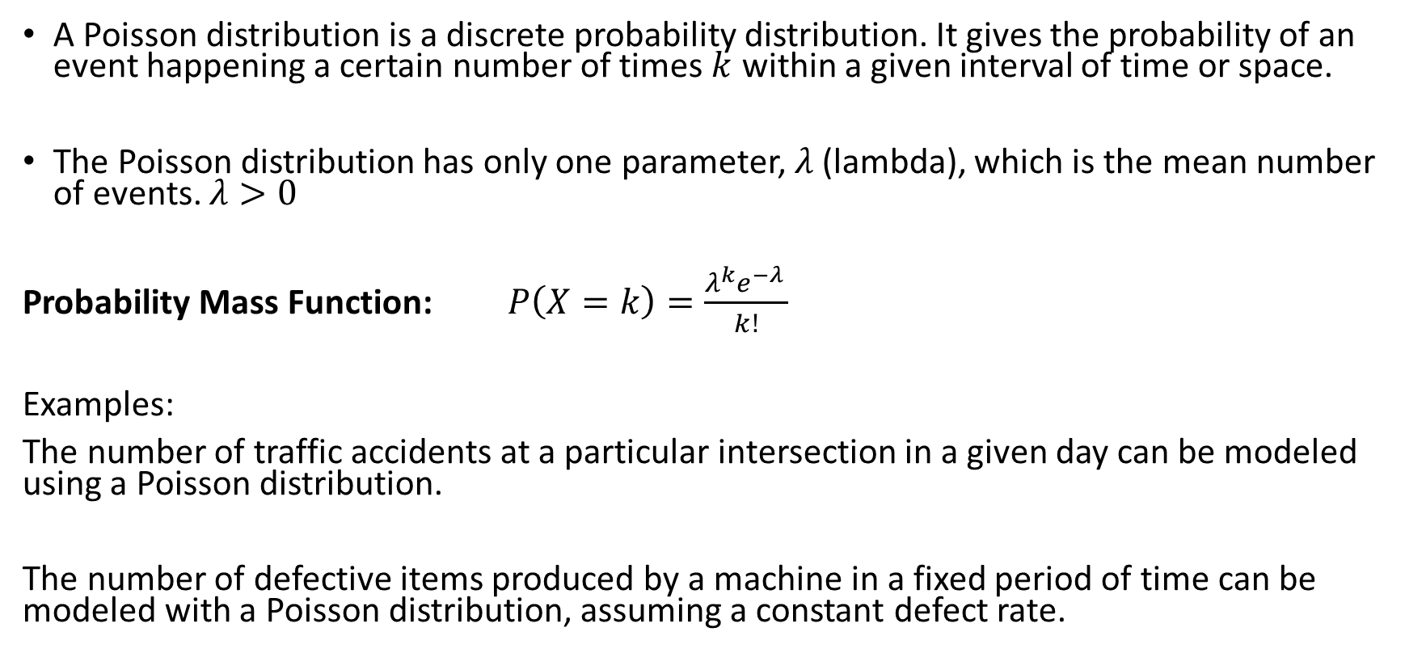
The Poisson Distribution
A Poisson distribution is a discrete probability distribution. It gives the probability of an event happening a certain number of times $k$ within a given interval of time or space.
The Poisson distribution has only one parameter, $λ$ (lambda), which is the mean number of events. $λ>0$
Probability Mass Function: $P\left(X=k\right)=\frac{λ^{k}e^{−λ }}{k!}$
Examples:
The number of traffic accidents at a particular intersection in a given day can be modeled using a Poisson distribution.
The number of defective items produced by a machine in a fixed period of time can be modeled with a Poisson distribution, assuming a constant defect rate.

Slide 10
Example:
Consider a scenario in the Star Wars universe where the number of rebel attacks on an Imperial outpost follows a Poisson distribution.
If the average rate of rebel attacks is 3.5 attacks per week, what is the probability of experiencing exactly 5 rebel attacks in a given week
What is the probability of experiencing less than 2 attacks in a given week?

Slide 11
Continuous Random Variables
Recall that a continuous random variable is a random variable with an uncountable number of values
Finding probabilities for continuous random variables requires a different mathematical treatment.
- we cannot simply list the possible values of a continuous random variable and their probabilities
The probability distribution of a continuous random variable is typically represented by a function, which we will usually consider graphically
- This function relates the value of the random variable to its probability density

Slide 12
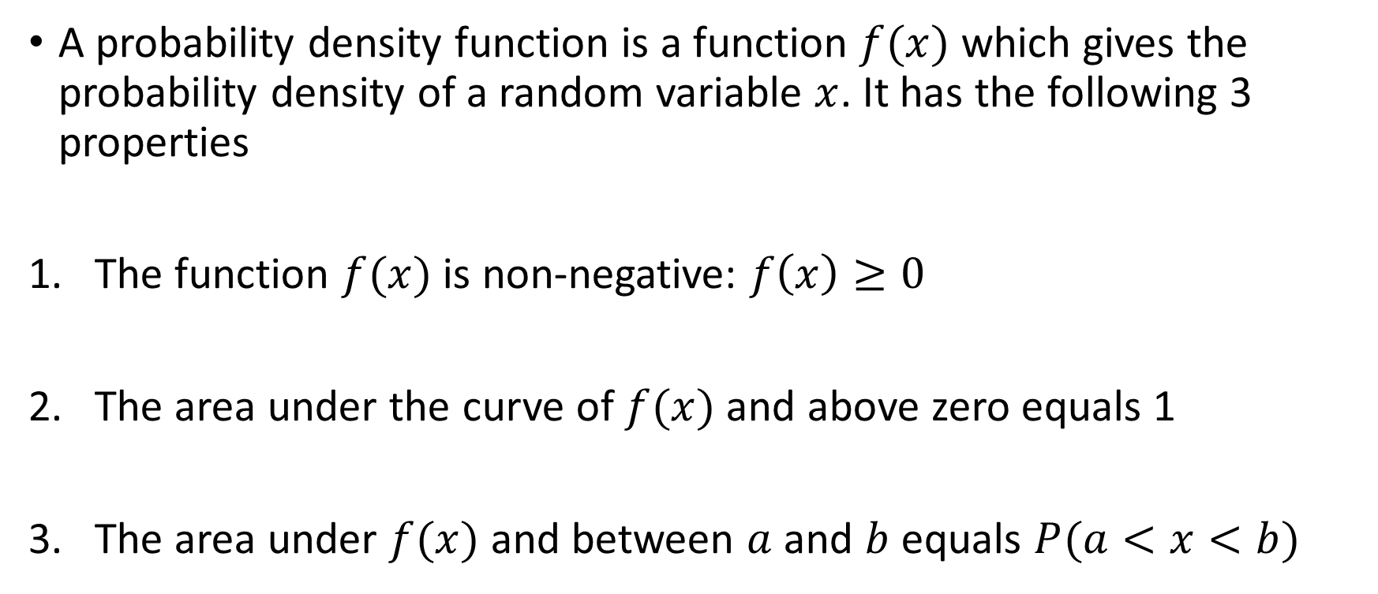
Probability Density Functions
A probability density function is a function $f(x)$ which gives the probability density of a random variable $x$. It has the following 3 properties
The function $f(x)$ is non-negative: $f\left(x\right)≥0$
The area under the curve of $f(x)$ and above zero equals 1
The area under $f(x)$ and between $a$ and $b$ equals $P(a<x<b)$

Slide 13
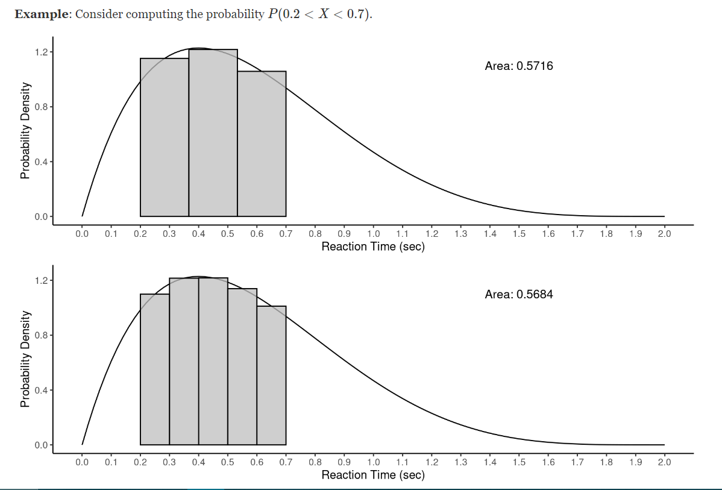
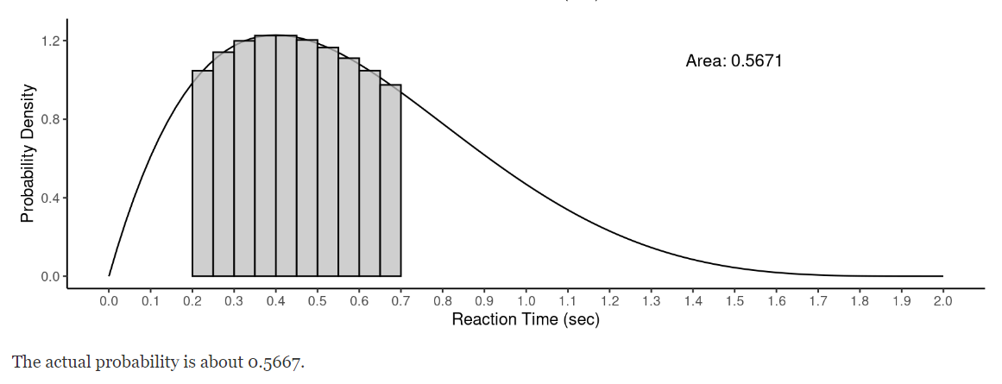
Approximating Probabilities of Continuous Distributions

Slide 14
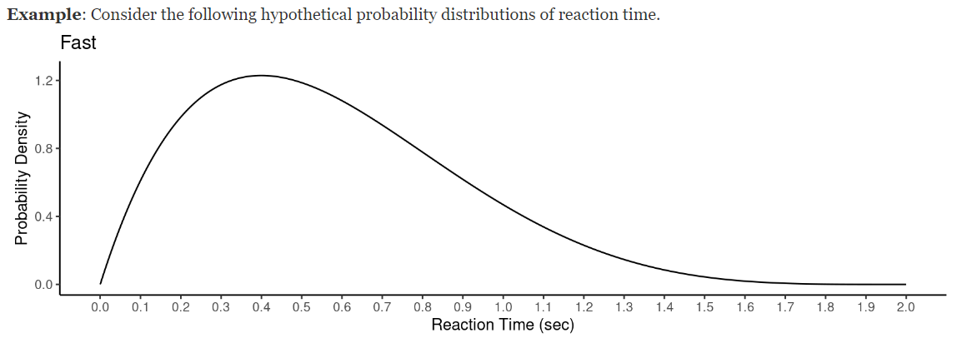
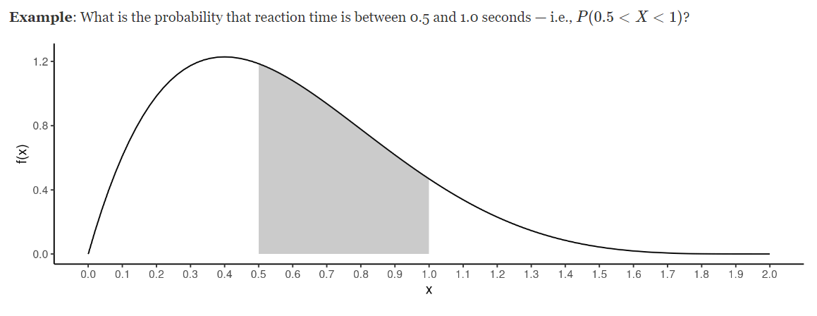

Slide 15
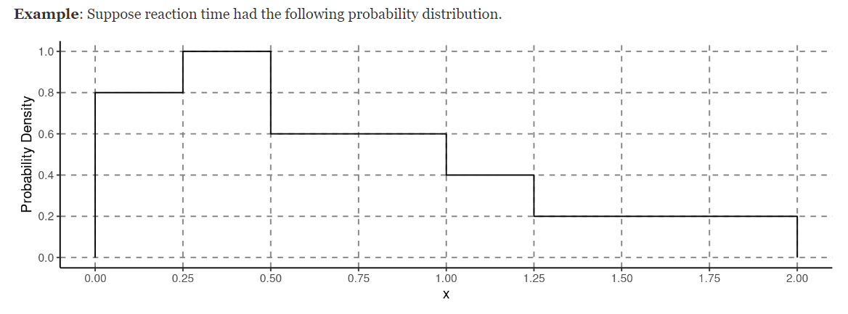
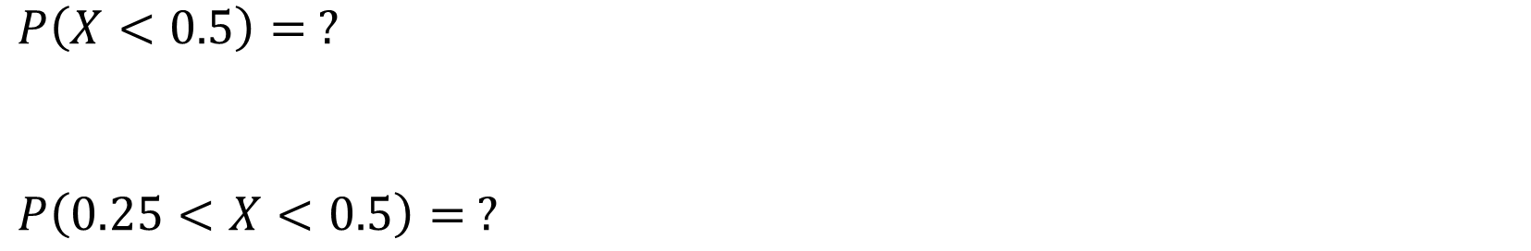
$P\left(X<0.5\right)= ?$
$$P\left(0.25<X<0.5\right)= ?$$

Slide 16
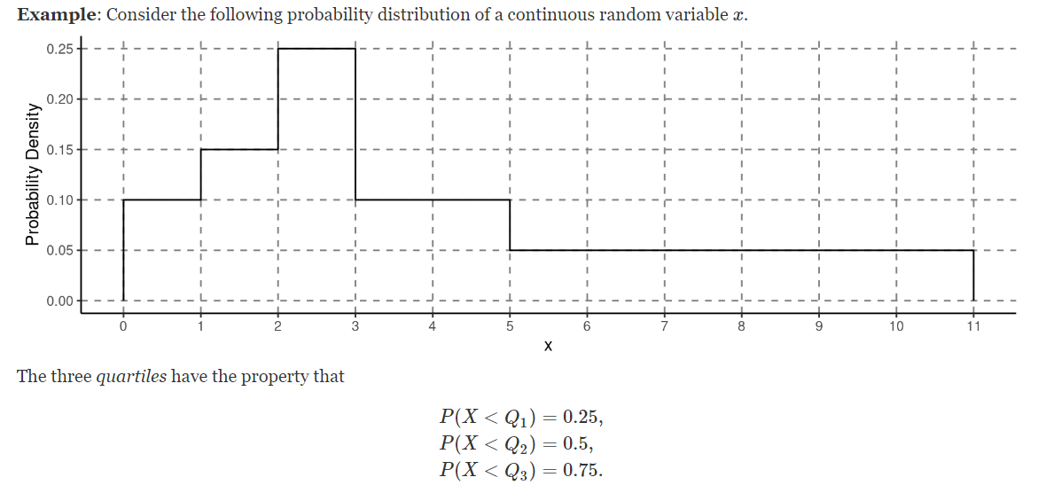
Quartiles

Slide 17
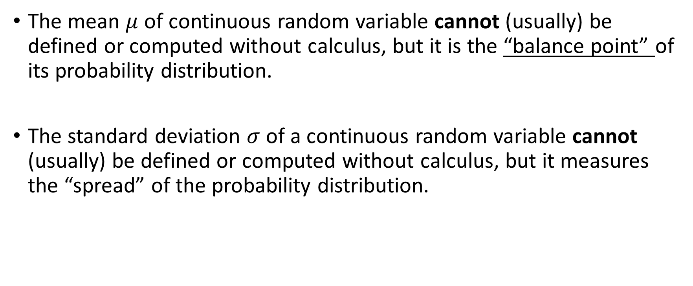
Mean and variance of Continuous Random Variables
The mean $μ$ of continuous random variable cannot (usually) be defined or computed without calculus, but it is the “balance point” of its probability distribution.
The standard deviation $σ$ of a continuous random variable cannot (usually) be defined or computed without calculus, but it measures the “spread” of the probability distribution.

Slide 18
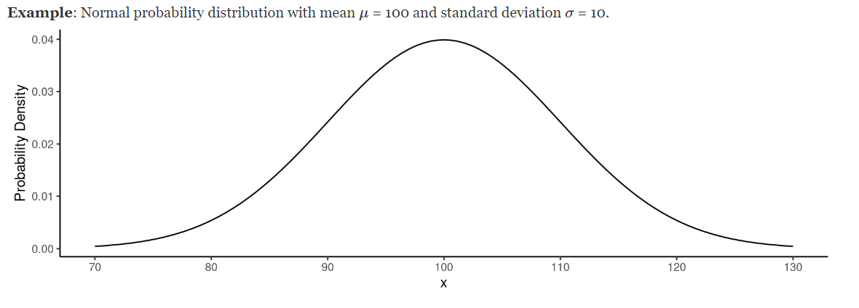
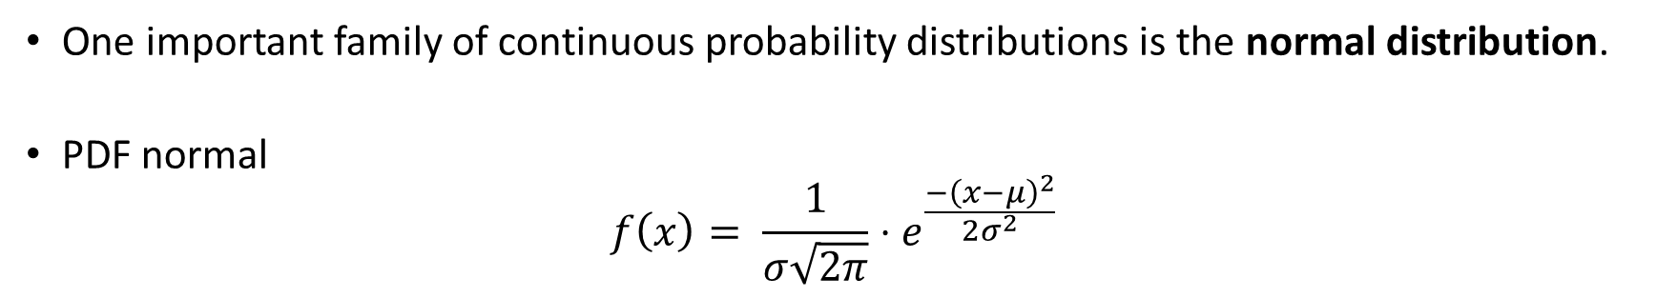
The Normal Distribution
One important family of continuous probability distributions is the normal distribution.
PDF normal
$$f\left(x\right)= \frac{1}{σ\sqrt{2π}}⋅e^{\frac{−{\left(x−μ\right)}^{2}}{2σ^{2}}}$$

Slide 19
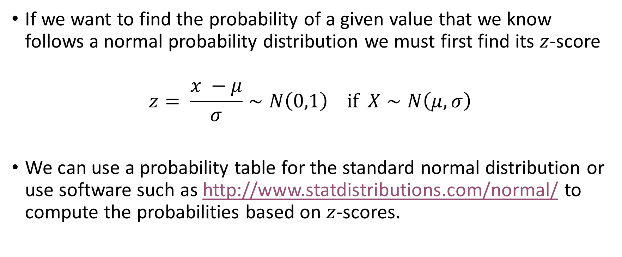
Computing Probabilities From A Normal Distribution
If we want to find the probability of a given value that we know follows a normal probability distribution we must first find its $z$-score
$$z= \frac{x −μ}{σ}∼N\left(0,1\right) if X∼N\left(μ, σ\right)$$
We can use a probability table for the standard normal distribution or use software such as http://www.statdistributions.com/normal/ to compute the probabilities based on $z$-scores.

Slide 20
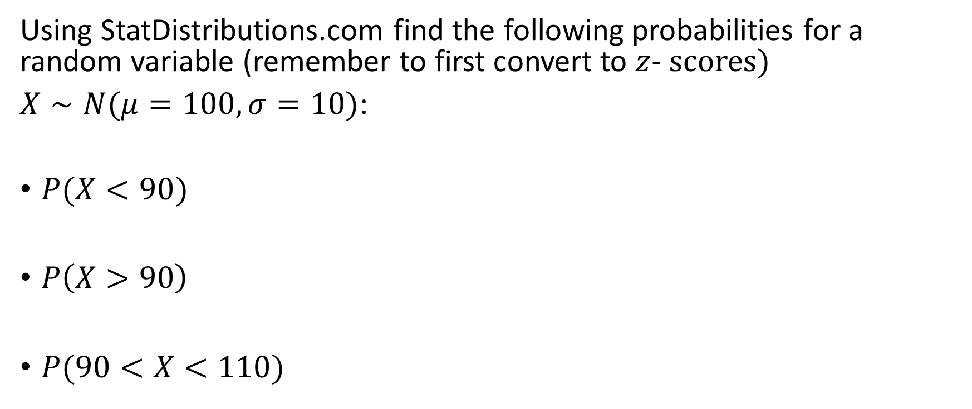
Examples:
Using StatDistributions.com find the following probabilities for a random variable (remember to first convert to $z$- scores)
$X∼N(μ=100,σ=10)$:
$P(X<90)$
$P\left(X>90\right)$
$P(90<X<110)$

Slide 21
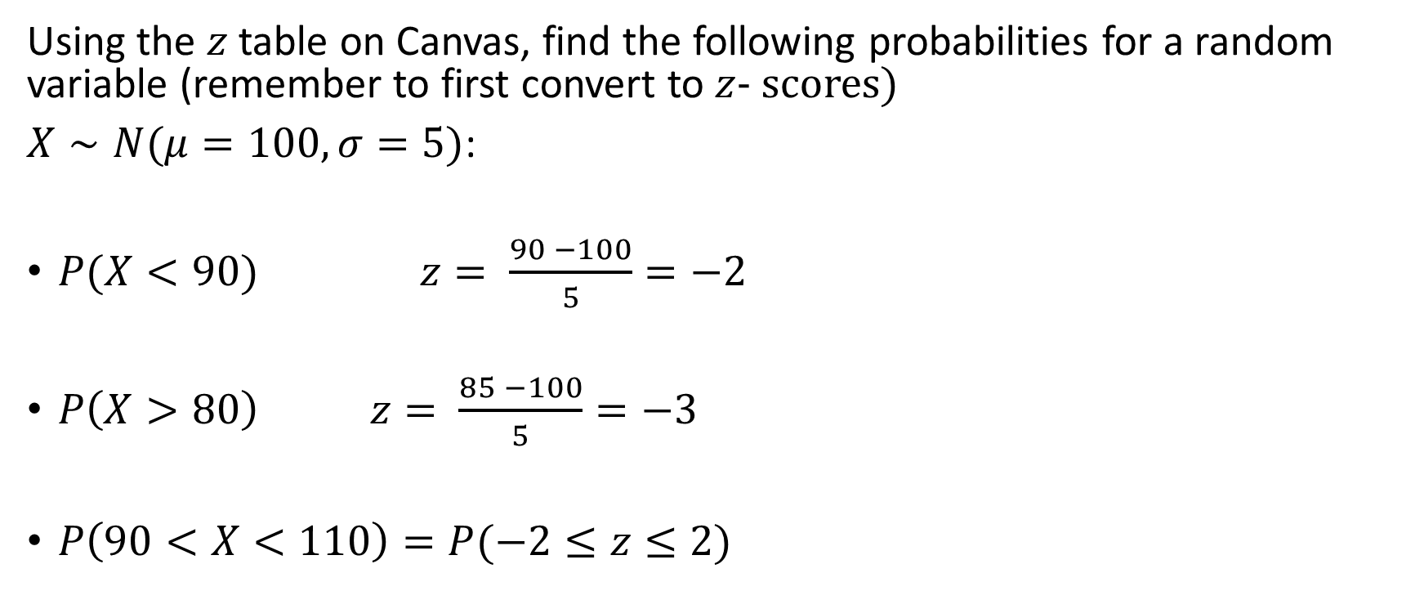
Examples:
Using the $z$ table on Canvas, find the following probabilities for a random variable (remember to first convert to $z$- scores)
$X∼N(μ=100,σ=5)$:
$P(X<90)$ $z= \frac{90 −100}{5}=−2$
$P\left(X>80\right)$ $z= \frac{85 −100}{5}=−3$
$P\left(90<X<110\right)=P(−2≤z≤2)$

